Slide 1
Airline Safety
By Zack DeNoto

Slide 2
Topics Covered
Incidents
Fatal Incidents
Motor Vehicle Fatalities
Airline Fatalities

Slide 3
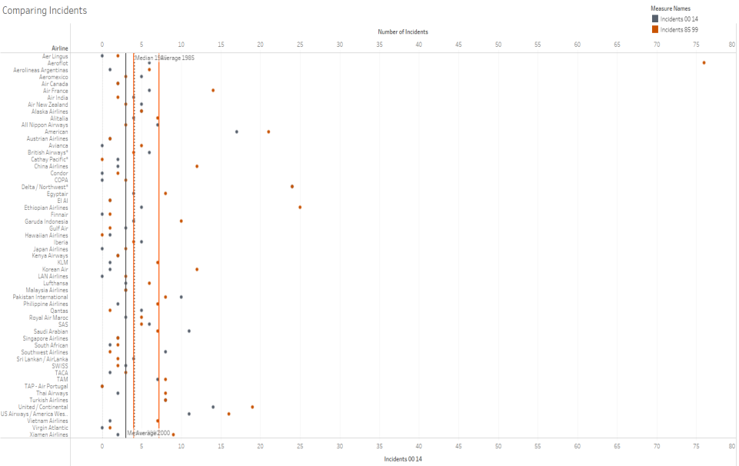
Comparing Airline Incidents

Slide 4
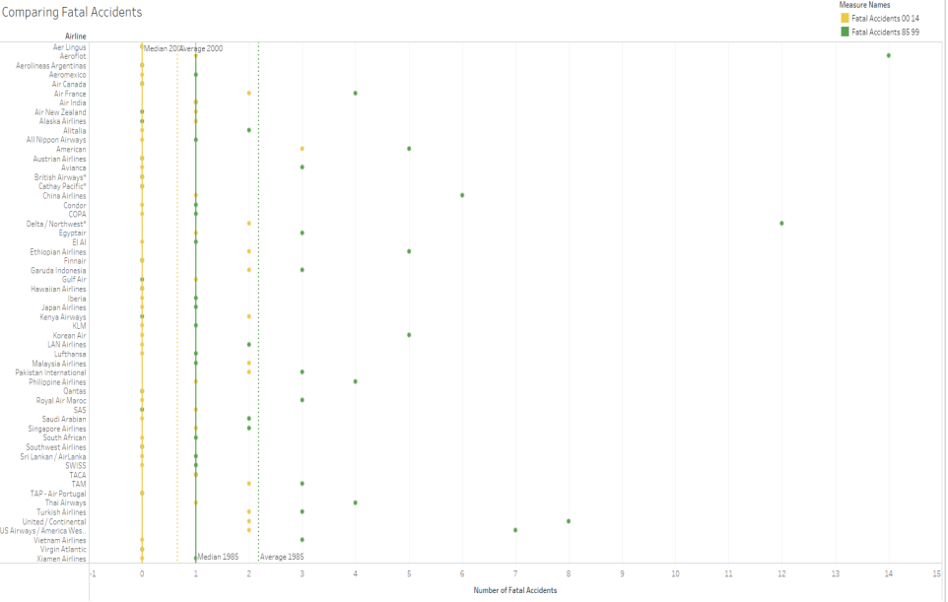
Comparing Fatal Airline Incidents

Slide 5
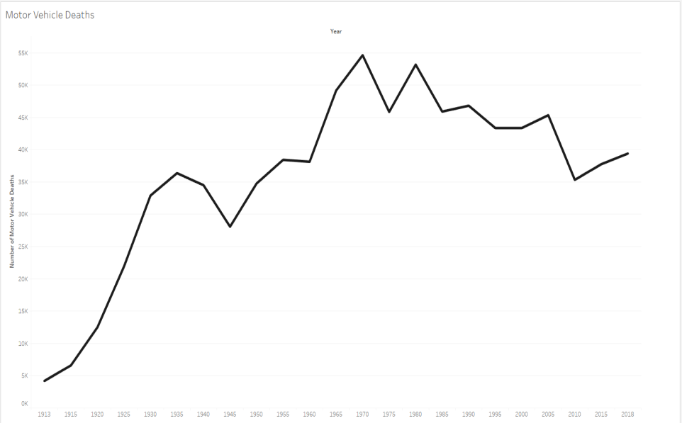
Motor Vehicle Deaths

Slide 6
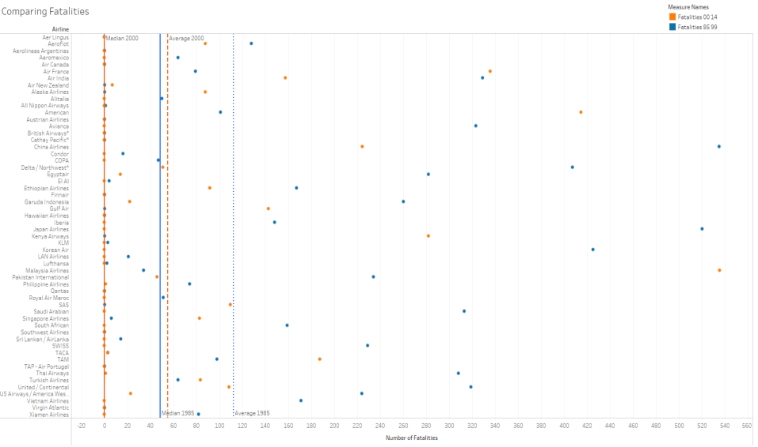
Comparing Airline Fatalities

Slide 7
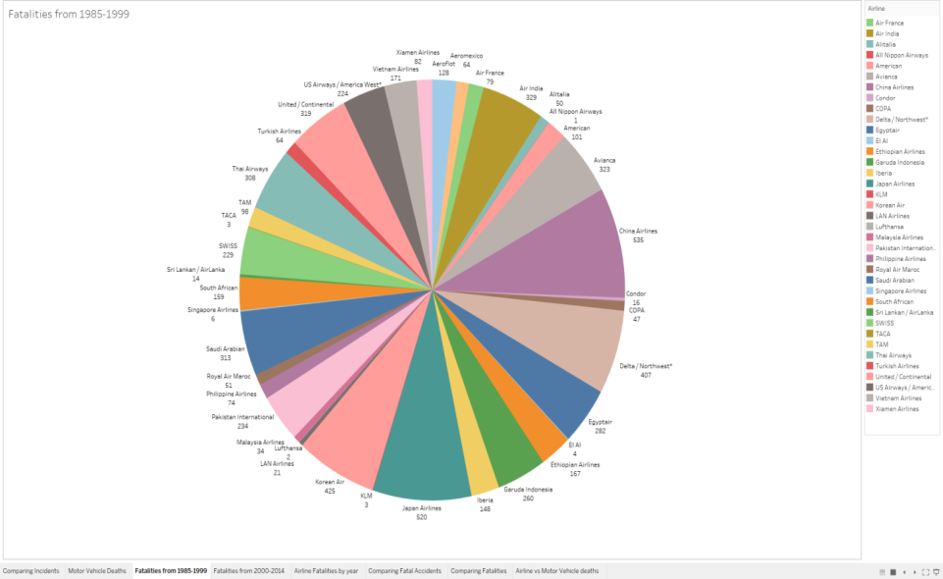
Airline Deaths from 1985-1999

Slide 8
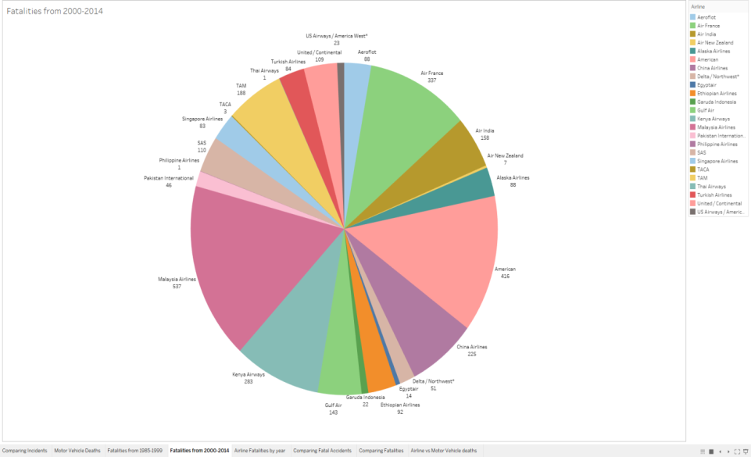
Airline Deaths from 2000-2014

Slide 9
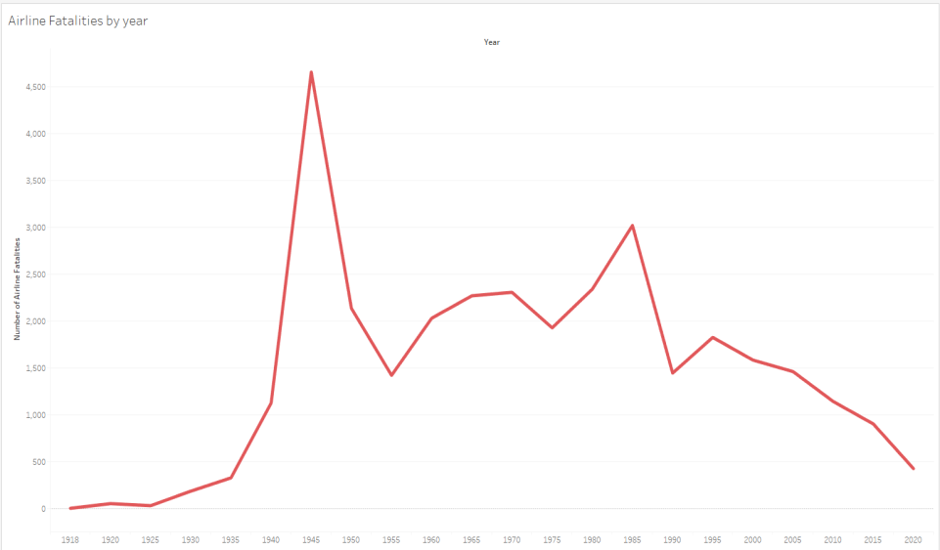
Airline Deaths from 1918 to 2010

Slide 10
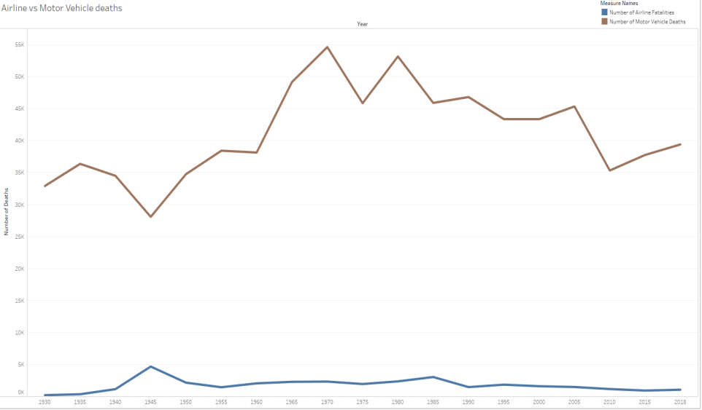
Airline vs. Motor Vehicle Deaths

Slide 11
Conclusion
Airline incidents, fatal incidents, and fatalities are currently much lower compared to previous years.
There are many more motor vehicle deaths as compared to airline deaths.
Motor vehicle deaths have not been on a steady decline in recent years as airline deaths have.
The airline industry has received more negative press from far fewer deaths compared to motor vehicles, which are much more deadly.

